Slide 1


Slide 2
Pipeline Overview
Load data and Prepare features
Normalize Data and create Sequences
Train and evaluate LSTM Model
Implement backtesting with dynamic ATR Thresholds
Compare strategy performance with buy-and -hold
Future Recommendations

Slide 3
Building Inputs for Predictive Analysis
Selected Features: -Close, Volume, Bollinger Bands, SMA, RSI, MACD, ATR, OBV
Normalize Data:
-Use MinMaxScaler to scale features to [0,1]
-Normalize input features (x) and target variable(y)
Create Sequences:
-Input Sequence: Consecutive data slices
-Output Sequences: Next 5 time steps for target variable

Slide 4
SMA Crossover Strategy
Determine state of volatility using historic and current ATR(14).
Threshold for high volatility → Historic Mean_ATR + 2*Standard_Deviation.
Multiplier for the SD varies across assets.
Identify SMA Crossovers using SMA20 and SMA140.
Buy When SMA20 goes above SMA140.
Sell When SMA20 goes below SMA140.
Change the sell strategy to leverage the predictions from LSTM strategy.
Sell when predicted increase is significantly less than the sell threshold.
Prevent the SMA strategy to buy in next few hours. Instead use LSTM model for that time period.

Slide 5
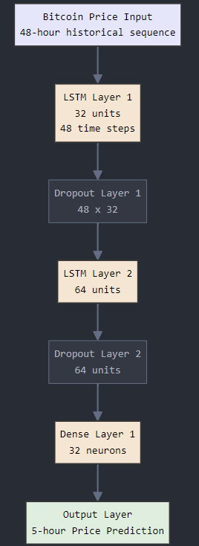
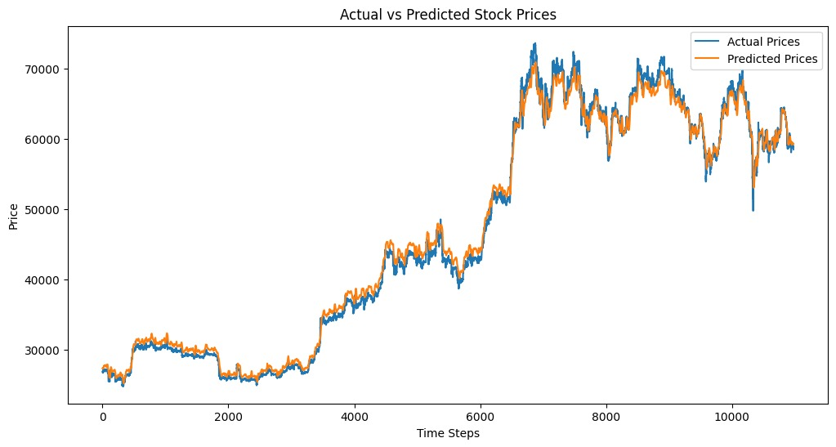
LSTM Model Overview
Long Short Term Memory (LSTM) is a type of Recurrent Neural Network (RNN)
Includes gates for managing long-term and short-term memory
Input Layer: Takes sequential input of 48 time steps
LSTM Layers: Capture temporal dependencies
Dropout Layers: Prevent overfitting
Dense Output Layer: Predicts the next 5 steps
Optimizer: Adam
Loss Function: Mean Average Error (MAE) = 0.0118
Early Stopping: Prevents overfitting.

Slide 6
LSTM Trading Strategy
Compare predicted future price (5th hour) with actual closing price
Dynamic threshold based on rolling volatility(window = 20 hours).
Trigger buy when the predicted price increase exceeds a dynamic threshold.
Trigger sell when the predicted price decrease exceeds a negative threshold.
RSI value(current sequence) is below lower quartile of Mean RSI(historical): Indicates oversold market conditions, signaling a potential buy.
RSI value(current sequence) is above upper quartile of Mean RSI(historical): Indicates overbought market conditions, signaling a potential sell.
Used alongside LSTM predictions to ensure alignment between predicted price movements and market momentum.
Entry:
Predicted > Dynamic Threshold or RSI(curr seq) < LQ(Mean RSI)
Exit:
Predicted < Dynamic Threshold and RSI(curr seq) > UQ(Mean RSI)

Slide 7
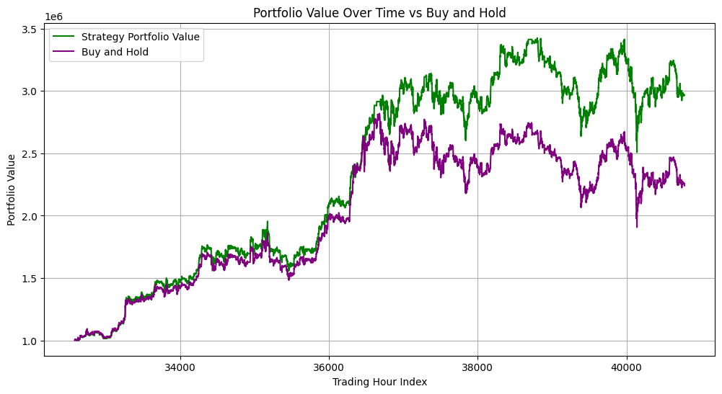
Results BTC
Strategy Portfolio:
Total Return: 196.82%
Number of Trades: 850
Sharpe Ratio: 2.59
Sortino Ratio: 3.32
Results Buy and Hold:
Total Return: 123.90%
Sharpe Ratio: 1.88
Sortino Ratio: 2.42

Slide 8
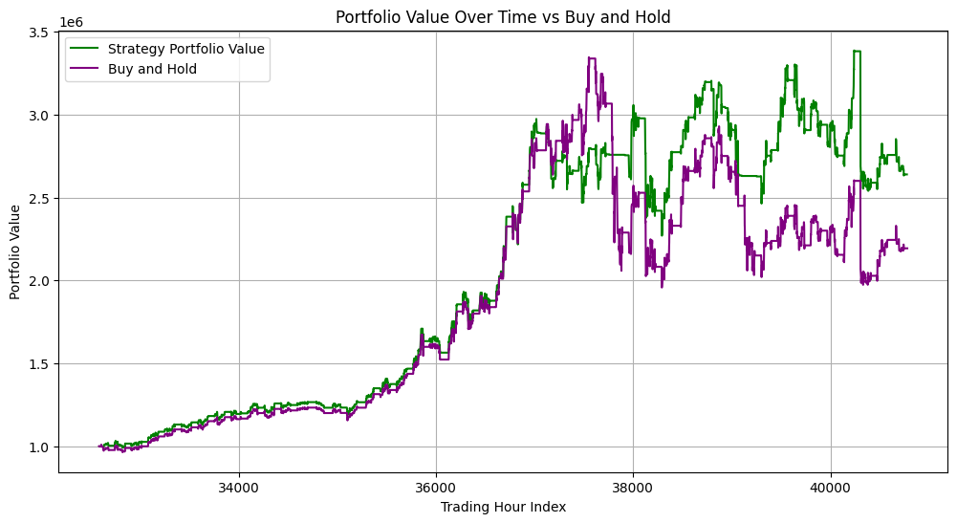
Results COCOA
Strategy Portfolio:
Total Return: 163.88%
Number of Trades: 1642
Sharpe Ratio: 2.16
Sortino Ratio: 1.19
Buy and Hold:
Total Return: 118.27%
Sharpe Ratio: 1.57
Sortino Ratio: 0.87

Slide 9

Comparative Analysis
 | Trading Window | No. of Trades | Sharpe Ratio | Sortino Ratio | LSTM + SMA | LSTM | Buy & Hold
BTC | 11 Months | 815 | 2.59 | 3.32 | 196.82% | 156.57% | 123.90%
COCOA | 11 Months | 1642 | 2.16 | 1.19 | 163.88% | 131.13% | 118.27%

Slide 10
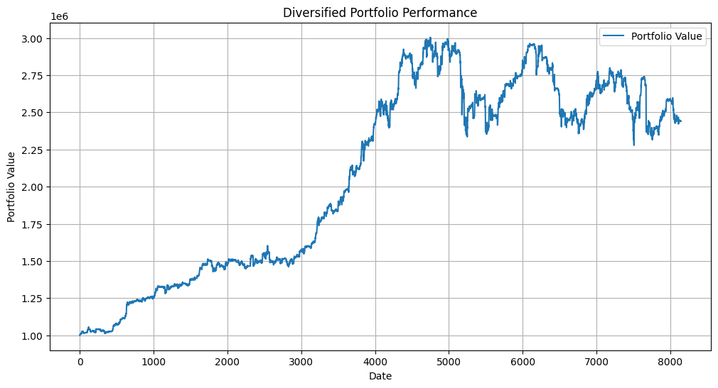
Portfolio Optimization & Future Scope
Dynamic Weight Adjustment: Implement strategies for adaptive rebalancing based on market trends, volatility, and asset performance.
Diversify Across Asset Classes: Optimize for uncorrelated assets to enhance diversification benefits.

Slide 11
THANK YOU!

